Slide 1
Creating Cross Platform Apps with Xamarin

Slide 2

Xamarin
Xamarin is the the home for “Mono”
MonoTouch
MonoGame
….
Allows you to write C# applications that run on
Android
iOS
Mac OSx
And of course Windows 8 and Windows Phone 8

Slide 3
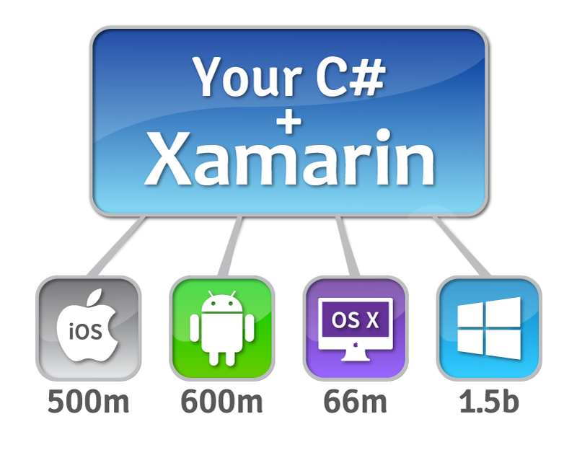
Image from xamarin.com/tour

Slide 4
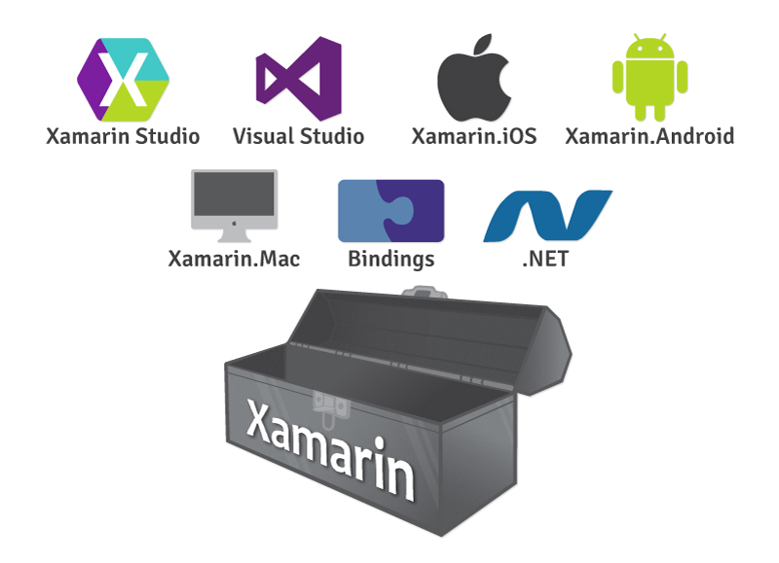
Image from xamarin.com/tour

Slide 5
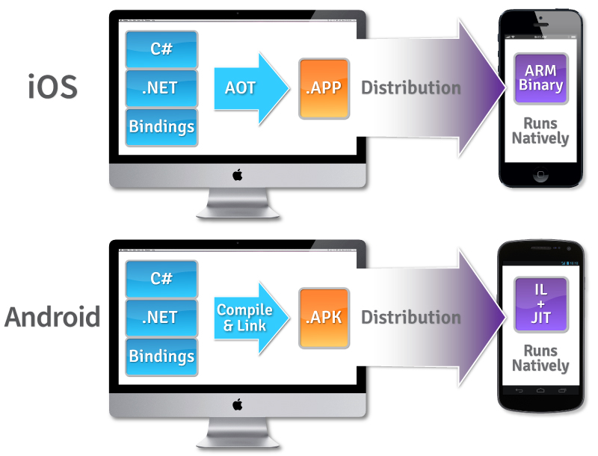
Image from xamarin.com/how-it-works

Slide 6

Learn More at Xamarin.com

